Slide 1
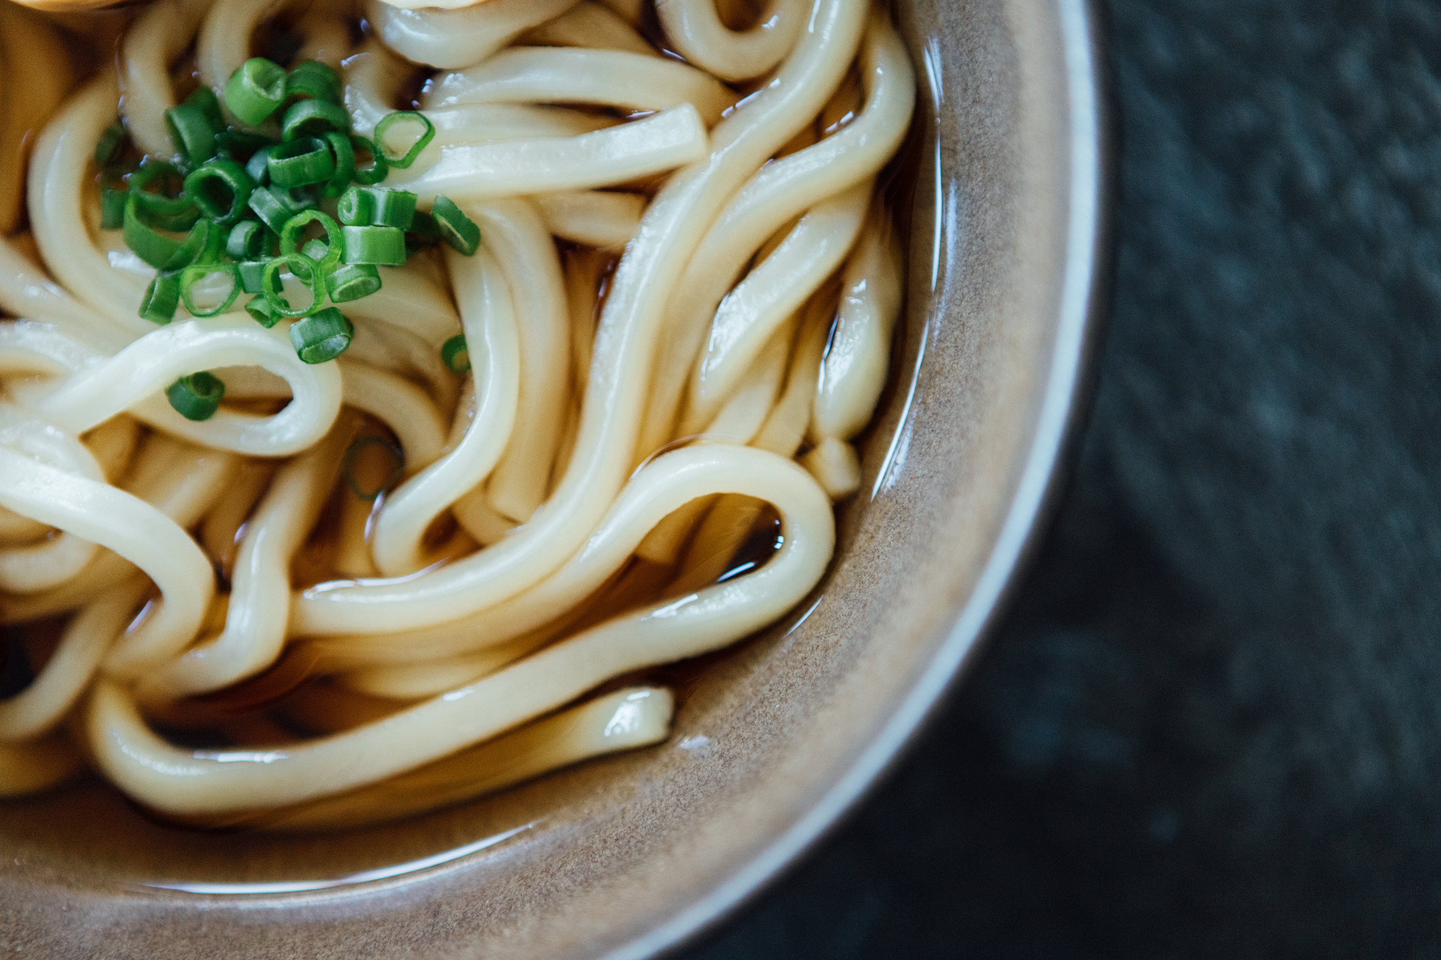
Homemade Noodle pots
You will need:
A kettle, a large pan with lid, a teaspoon, maybe a tin opener, a cooking spoon, tongs (or 2 forks) to serve
Ingredients for 4 servings: A=potential allergen
Boiled water 500-700mls (boiled in a kettle uses less energy than boiling in a pan)
1-2 stock cubes (A=celery)
Garlic paste, ginger paste, (chilli flakes if you want spicy)
Dried noodles approx. 250g (A=wheat/ gluten, egg)
A small can of peas and a small can of sweetcorn
Salted peanuts, small handful for each bowl (A=peanut)
If you make this again
Vary the vegetables to suit what you have, e.g. cooked leftover veg or frozen. Instead of nuts leftover meat can be added to the broth or boil/ fry an egg to top the noodles. The broth is tasty too so you could have a noodle soup if you like.
How to make (spicy) noodles
1. Choose a large pan because the noodles get thicker as they cook. Use boiled water from the kettle to dissolve the stock cubes in the pan on the heat while it comes back to a simmer. Lid on.
2. Squeeze 2 teaspoons of ginger paste and 1 teaspoon of garlic paste into the water. Also add 1 teaspoon of dried chill flakes now if you want spicy noodles. This is your cooking broth.
3. Break up the noodles, add and cook in the simmering broth according to the packet, about 5 minutes.
4. Drain the liquid from the canned peas and sweetcorn. When the noodles have softened and separated but are still cooking add these to the noodles and stir gently to heat through.
5. When the noodles are soft and the peas and sweetcorn are hot you are ready to serve. Sprinkle over the salted peanuts.

Slide 2
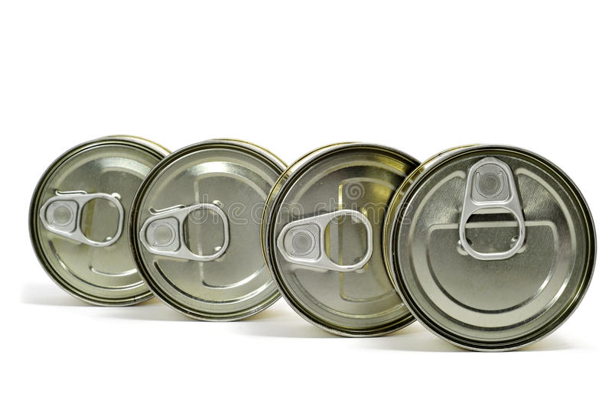
U can 4 can Chilli
You will need: a large pan, a sieve or colander, a wooden or cooking spoon, a tablespoon.
Ingredients for 4-8 servings: (A=potential allergen)
1 can of beans (e.g. cannellini, kidney, black, butter), 1 can sweetcorn and 1 can of tomatoes.
Garlic paste, medium chilli powder or chilli flakes, ground cumin, smoked paprika, dried oregano, tomato puree, 1 stock cube (A=celery)
1 can of baked beans
If you make this again:
Use passata instead of can of tomatoes. Use can of drained lentils or 2 cans of different beans instead of sweetcorn. Use siracha sauce instead of chilli. Use half meat and half beans or lentils.
Serve with rice or baked potato or wedges, or wrap into a quesadilla, taco or burrito or with tortilla chips like nachos. Very versatile!
How to make U can 4 can Chilli
Drain and rinse the can of beans in a sieve or colander. Add to the pan along with the can of sweetcorn and tin of tomatoes. Break up whole tomatoes with the cooking spoon.
Add a tablespoon each of the garlic, oregano, chilli, smoked paprika, cumin and tomato puree. Dissolve the stock cube in the tomatoey bean mixture stirring until completely blended in. The sauce should ‘blip’ gently while cooking.
Taste the sauce after 10 mins when everything has mixed and heated through. If you add more of something cook for another 5 mins stirring to mix everything well.
Lastly add in the can of baked beans including its sauce and cook for another 5 mins stirring until everything is hot.
Cool and store leftovers in the fridge and reheat just as much as you need until piping hot to enjoy again.

Slide 3
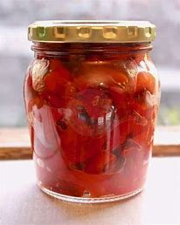
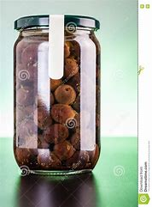
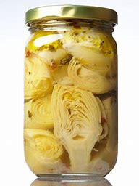
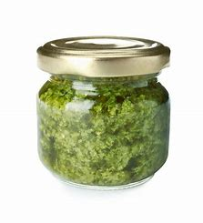
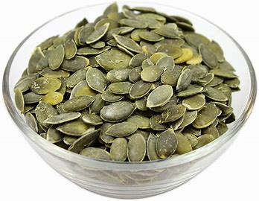
Pasta Mediterranean
You will need: kettle, large pan with lid, mug, sieve or colander, sharp knife, chopping board or plate, spoon which fits into open jars
Ingredients: increase the quantity depending on how many portions you want (A=potential allergen)
Pasta (75g or a mug full dry each) (A=wheat/ gluten)
Boiled water 500-700mls (boiled in a kettle uses less energy than boiling in a pan)
Variety of 2 or 3 jars of Mediterranean vegetables for example roasted peppers, artichokes, olives, sun dried tomatoes, capers. Check which ones are packed in oil.
Jar of pesto (optional), one teaspoon per portion (A=milk/ cheese, egg, nuts)
pumpkin seeds
If you make this again: you can roast vegetables from the jars with other vegetables first, some charring will add flavour. You could add chickpeas, nuts, tuna or mackerel. You can add herbs of your choice.
How to make Pasta Mediterranean
Choose a large pan because the pasta gets thicker as it cooks. Cook the pasta in plenty of boiling salted water according to the time on the packet. Lid on and simmer (like boiling but not as fierce) .
While the pasta is cooking choose the vegetables that you want to add. Cut into bite size pieces.
Carefully take some of the hot pasta water out in a mug when the pasta is cooked. Drain off the rest of the boiling water very carefully.
Put the chopped vegetables into the still hot pasta pan with a little of the oil from one of the jars. Add the drained pasta back to the pan with the vegetables and over a very low heat stir together to heat the vegetables through. Add some of the pasta water to stop sticking if necessary and create a light shiny sauce.
You can serve this now, with or without a little pesto stirred in. Sprinkle with sunflower seeds.
Leftovers are also delicious as a pasta salad so make more than you need and store in the fridge to enjoy again.

